Slide 1
Bank Loan Case Study
By Sonali Gupta

Slide 2
Project Description
The main aim of this project is to identify patterns that indicate if a customer will have difficulty paying their installments.
The information can be used to make decisions such as denying the loan, reducing the amount of loan, or lending at a higher interest rate to risky applicants.
The company wants to understand the key factors behind loan default so it can make better decisions about loan approval.
I will be using Exploratory Data Analysis (EDA) to analyze patterns in the data and ensure that capable applicants are not rejected.

Slide 3

Tech-Stack Used
To complete this project, I am using MS Excel 2021 as the given dataset is small in size and it is an excellent analysis tool to analyze small size datasets.
It can also be used for data visualization and drawing insights from it.
Also, I will be using MS Power Point and MS Word to form a report.

Slide 4
Approach
First, I will clean the dataset by handling missing values, checking for outliers, deleting any columns which are not required for analysis, converting data types if necessary in the dataset.
The given data contains two dataset: application_data file which contains details about the current loan applications and previous_application file which contains information about previous loan applications.
I will be using Exploratory Data Analysis (EDA) which is a statistical approach used for analyzing and visualizing data sets to uncover patterns, trends, and relationships between variables.
It will also going to help me to gain various insights.

Slide 5
1. Identify Missing Data and Deal with it Appropriately
Before cleaning, the given file named application_data contains 50,000 rows and 122 columns in total and after cleaning the given file, it contains 49961 rows and 22 columns.
Also, earlier previous_aaplication file contained 50,000 rows and 38 columns, and after cleaning, it now contains 49992 rows amd 22 columns.
One column is a calculated column named age_of_applicant (in yrs) as the age of the applicant was given in days and by using =int(ABS(P2)/365) formula the age of the person in years has been derived in excel in application_data file.
I have removed several rows that contains blank values.

Slide 6
I have deleted a large number of unwanted columns that are not going to help with the analysis.
I have also replaced house / apartment with house, secondary / secondary special with secondary education and single / not married with not married in application_data file.
I have also used =isblank() function in excel to check for blanks.
I have also replaced some blank values in column occupation_type with NG (not given) as deleting large amount of blank rows can result in the loss of some important information required for the analysis. Same has been done in previous_application file.

Slide 7
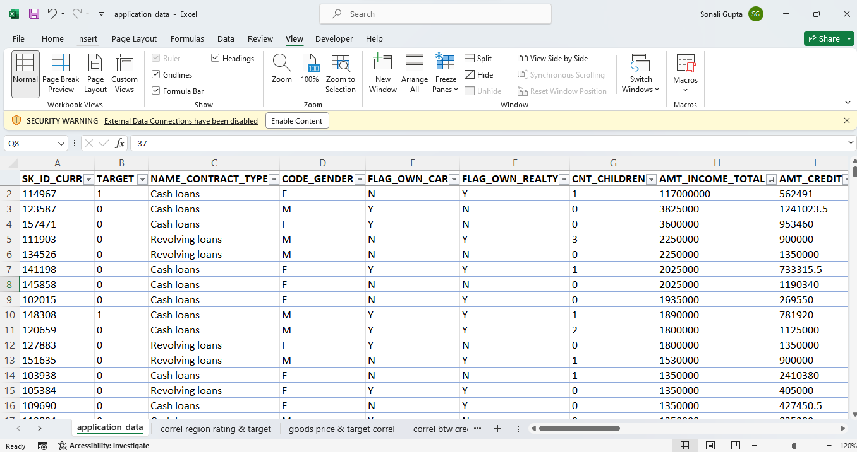
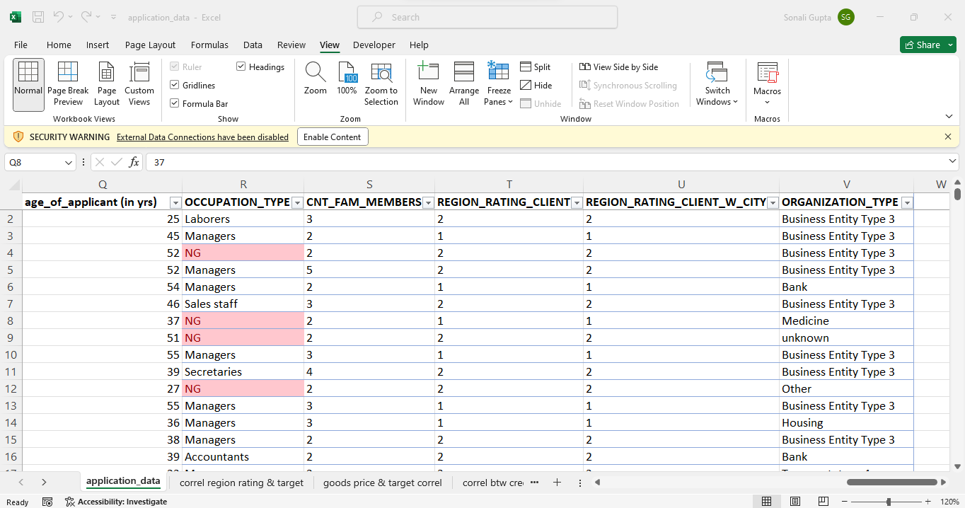
Screenshots
For application_data

Slide 8
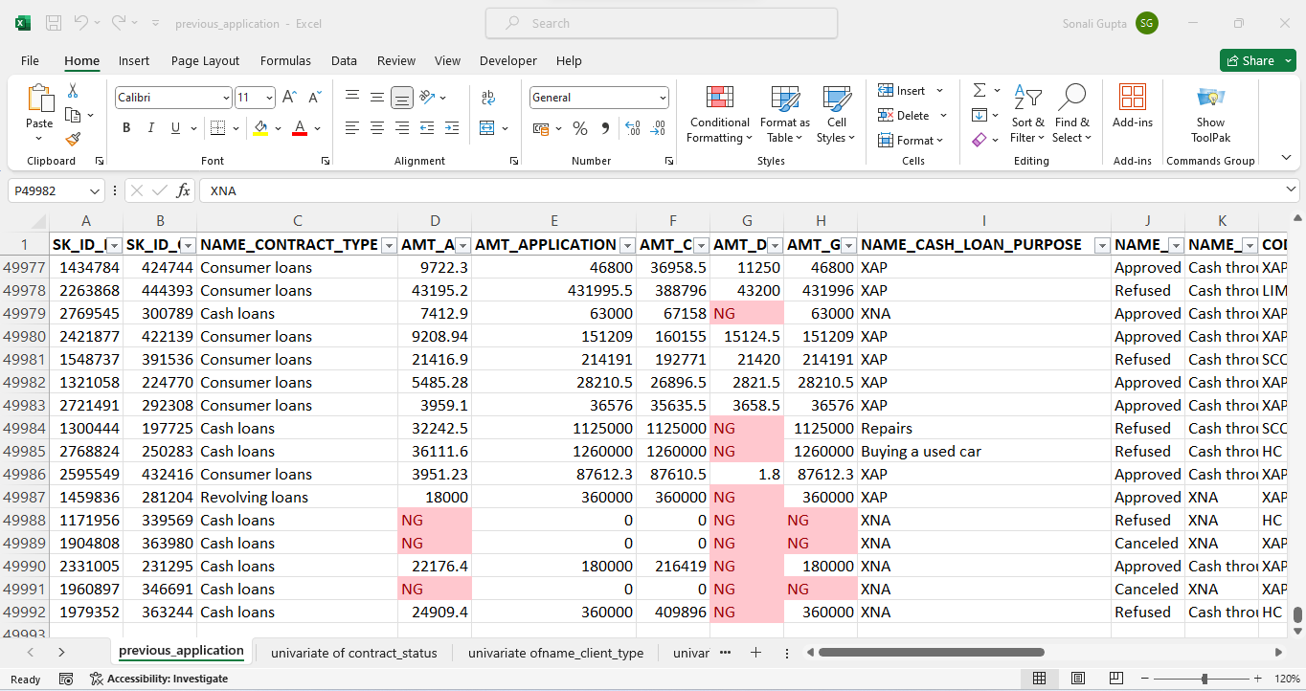
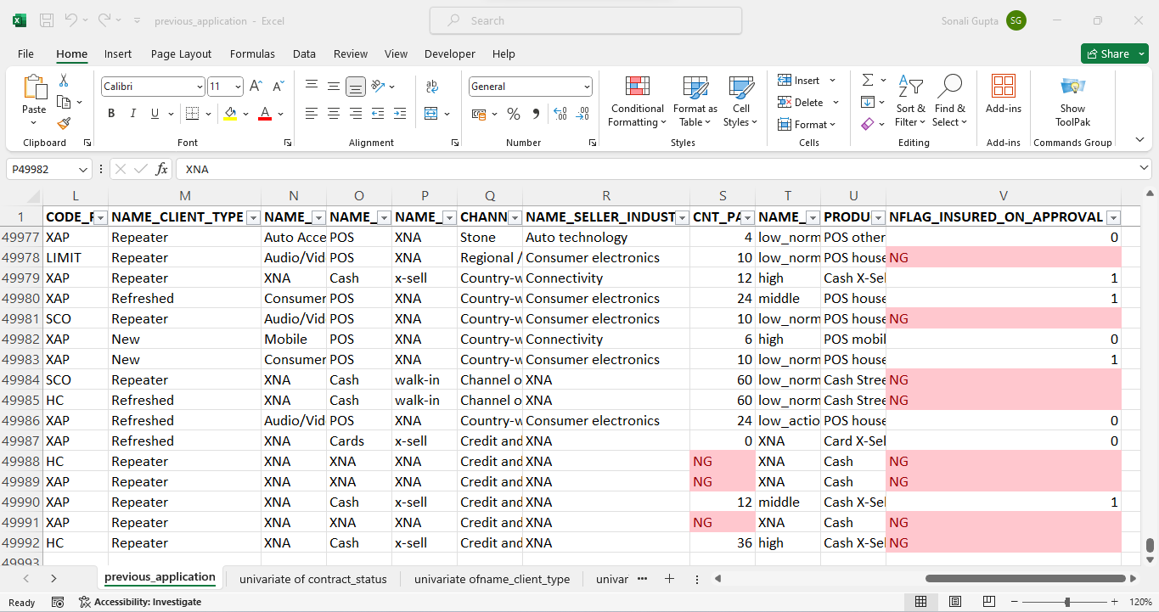
For previous_application

Slide 9
Here is the chart showing the count of blanks in the name_occupation_type column
The above chart is showing the number of blanks which I have replaced with NG(not given) in the name_occupation_type column as this column is going to be used for analysis and removing such huge amount of rows from the dataset can result into a skewed analysis.

Slide 10
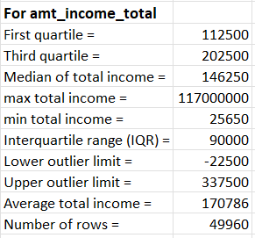
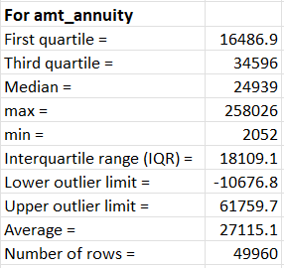
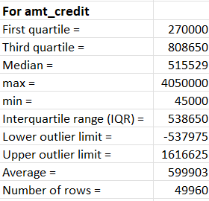
2. Identify Outliers in the Dataset
Outliers can significantly impact the analysis and distort the results. They can only be identified in columns that contains numerical values like amt_credit, amt_annuity, amt_income_total.
I have used quartile, IQR and average functions in excel to identify outliers in application_data.

Slide 11
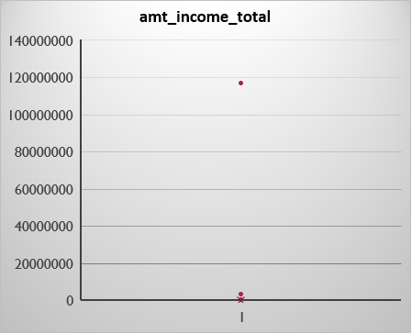
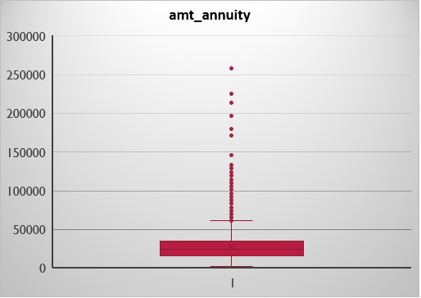
Box plot Showing the Outliers present In the numerical values

Slide 12
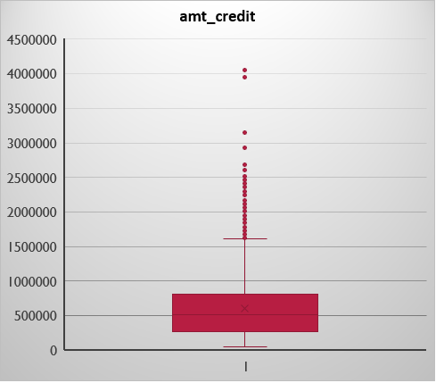
Insights Gained:
The red colored dots are showing that outliers are present in the amt_income_total, amt_credit and amt_annuity. Also, few things has been derived like:
For amt_income_total, values lying below -22500 will be outliers and the values lying above 337500 will be outliers.
For amt_annuity, values lying below -10676.8 will be outliers and the values lying above 61759.7 will be outliers.
For amt_credit, values lying below -537975 will be outliers and the values lying above 1616625 will be outliers.

Slide 13



3. Analyze Data Imbalance
Data imbalance means when the data is classified into skewed class proportions and can affect the accuracy of the analysis, especially for binary classification problems. Below are the pivot tables showing the skewed class distributions for various variables along with target variable.

Slide 14
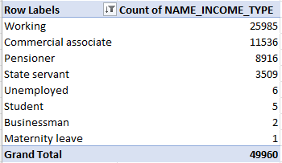
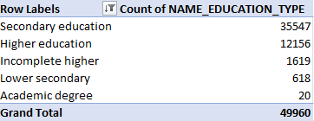
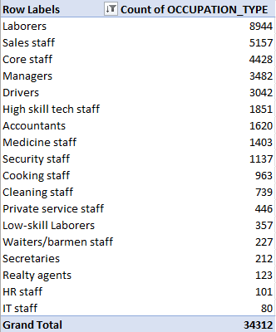
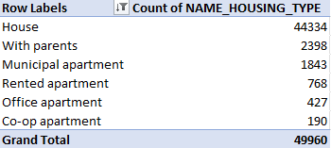
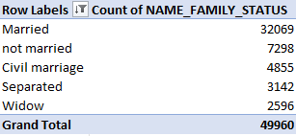

Slide 15
Graphical Representation
Insight Gained:
The above bar chart is showing the distribution of target variable which is showing that 0 means the payment of loan done on time is more than 1 means the late payment of loan.
Insight Gained:
The above bar chart is showing that the number of cash loans requested by customers is higher that revolving loans.

Slide 16
Insight Gained:
The above chart is showing that maximum number of people who applied for loans are working professionals.
Insight Gained:
The above chart is showing that more loans are applied by more females than males.

Slide 17
Insight Gained:
The above chart is showing that the maximum number of loans are applied by people who have secondary education.
Insight Gained:
The above chart is showing that maximum loans are applied by married people.

Slide 18
Insight Gained:
The above chart is showing that maximum number of loans are applied by the people with a house.
Insight Gained:
The above chart is showing that the maximum number of loans are applied by laborers than any other occupation type people.

Slide 19
Insight Gained:
The above chart is showing that the maximum number of loans are applied by the people living in the region with rating 2.
Insight Gained:
The above chart is showing that maximum number of loans are applied by people with organization type business entity type 3.

Slide 20
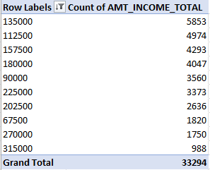
4. Perform Univariate, Segmented Univariate, and Bivariate Analysis
Univariate analysis is done to understand the distribution of a single variable. It includes:
Here is the pivot table and bar chart is showing the distribution of total income of first 10 applicants:
Insight Gained:
The above bar chart is clearly showing that the applicants with total income of 135000 has more financial capacity to repay loans. Also, the customers with more salary like 315000 are less likely to apply for loans.

Slide 21

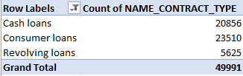
The below pivot charts are showing the distribution of the types of loans requested by applicants in application_data file and in previous_application file:
For application_data For previous_application

Slide 22
Graphical Representations:
For previous_application
For application_data
It is clear that only two types of loans are applied for by the applicants out of which cash loans are the most applied type of loan.
It is clear that three types of loans are applied by the applicants previously, out of which consumer loans was the most applied type of loan.

Slide 23
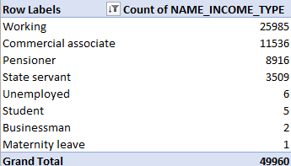
Below is the pivot table and chart showing the distribution of employments of current applicants:
As from the above chart, it is clear that most of the loans are applied by working professionals which means the stable income source. This means that applicants who are working professionals have more probability of getting their loan approved.

Slide 24
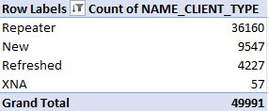
Below is the pivot table and chart showing the previous applicant’s nature:
Insight Gained:
After the analysis, it has been found that numbers of people who applied for loan repeatedly is high than the others which means that there is a possibility that the people who apply for loans repeatedly can be loan defaulters.

Slide 25
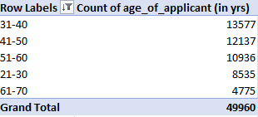
Below is the pivot table and chart showing the age distribution loan applicants:
Insight Gained:
The above bar chart is clearly showing that mostly of the loans are applied by people with age between 31 and 40 years.

Slide 26
Below is the pivot chart and chart showing the distribution of amount of credit asked by people mostly:
Insight Gained:
After analysis, it is clear that the amount of credit asked by most people ranges from 45000 to 1045000.

Slide 27
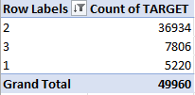
Bivariate analysis
It involves the examination and analysis of the relationship between two variables. The goal is to identify patterns, correlations, or dependencies between the chosen variables. It includes:
Region rating client Vs target variable
Insight Gained:
As from the above chart, it is clear that maximum loans applied by the applicants with region ratings 2 will most likely have more defaulters.

Slide 28
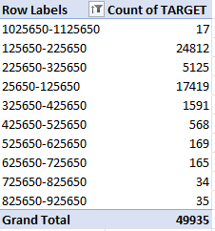
Total income Vs Target
Insight Gained:
After the analysis, it has been observed that people with low income will most likely be defaulters.

Slide 29
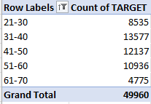
Age of applicants Vs target
Insight Gained:
From the analysis, it has been found that young people are most likely to be defaulters and defaulters are decreasing with increase in age.

Slide 30
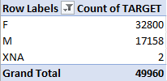
Gender of the applicants Vs Target
Insight Gained:
After the analysis, it has been found that females are less likely to be defaults than males.

Slide 31
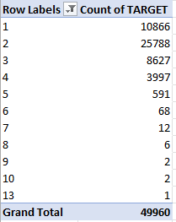
Family members Vs target
Insight Gained:
After the analysis, it has been found that people with more than 5 family members will most likely to be defaulters.

Slide 32
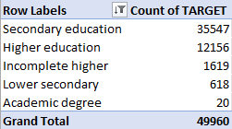
Educational Qualifications of applicant Vs target
Insight Gained:
After the analysis, it has been found that as most of the loans are applied by customers with secondary education, then it means that customers with low educational qualification will most likely to be defaulters.

Slide 33
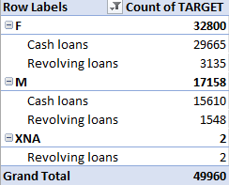
Segmented univariate analysis
It refers to the examination of individual variables within distinct subgroups or segments of a dataset. By conducting segmented univariate analysis based on various factors, data analysts can uncover insights that might be overlooked in a broad analysis. It includes:
Gender, contract type with target
Here is the pivot table showing the breakdown of type of
Loans with gender and target.

Slide 34
Graphical Representation:
The above chart is showing the breakdown of gender of applicants and type of loans applied by them with the target variable.

Slide 35
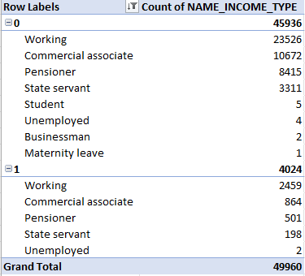
Income type with target
Here is the breakdown of income type of applicants with the target variable with chart.

Slide 36
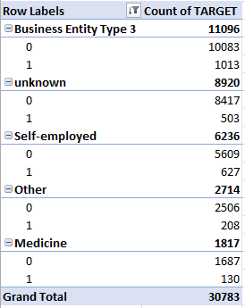
Organization type with target
Here is the pivot table and the chart showing the breakdown of organization type with target for top 5 professions.

Slide 37
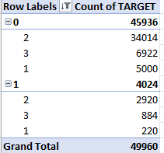
Ratings of a region with target
The above pivot table and chart are showing the breakdown of ratings of region of applicants with target variable.

Slide 38
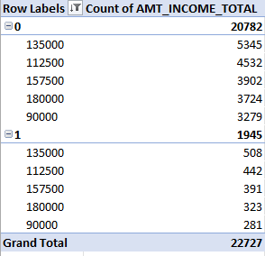
Total Income of the applicants with target
The above pivot table and chart are showing the breakdown of total income of applicants with target variables.

Slide 39
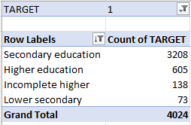
5. Identify top correlations for clients with payment difficulties and all other cases with the target variable.
Correlation between applicant’s qualification and target variable
After the analysis, it has been found that most likely the defaulters will be the people with secondary education.

Slide 40
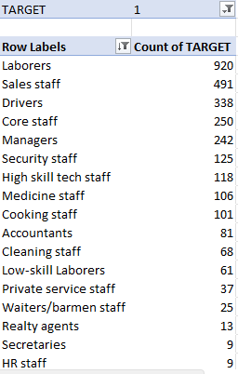
Correlation between occupation type and target
After the analysis, it has been found that most likely the defaulters will be the people who are laborers. I have not included NG (with whom I have replaced blanks in this column).

Slide 41
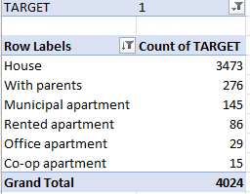
Correlation between housing type of applicants and target
After the analysis, it has been found that people who have house will most likely to be defaulters. Although, for the people with other housing types, the possibility of them being defaulters are very low as per the above chart.

Slide 42
Correlation between credit and target
I have used CORREL function in excel to find the correlation coefficient between amount of credit and target. The correlation coefficient is -0.03246. This means that a very weak negative correlation exists between them. Graphical representation will provide more clarity on their relationship.

Slide 43
Graphical representation:
Insight Gained:
After plotting the scatterplot between amount of credit and target, it is clear that no linear relationship exists between them.

Slide 44

Correlation between goods price and target
By using CORREL function, I have calculated correlation coefficient between goods price and target and it is -0.04131. This means a very weak negative relationship exist between them. Graphical representation will provide more clarity on their relationship.

Slide 45
Graphical representation:
Insight Gained:
As per the above scatterplot, no linear relationship exists between goods price and target.

Slide 46
Insights
After analyzing the data, we can predict whether a person will be able to repay the loan or not.
The people who are most likely to face problems in repaying the loan will be laborers.
Most likely the defaulters will be the people with secondary education.
It has been found that people who have house will most likely be defaulters (maybe due to EMI etc).
It has been found that people who are married will most likely be defaulters (maybe due to house loan, consumer loan etc).

Slide 47
Result
By doing an analysis of a loan application data, I have learned how to handle missing data. I learned that not every missing values needs to be removed from the dataset, as it can result in the loss of some important information required for the analysis.
Identify outliers present in the dataset. I also learned that after careful considerations and understanding of the context, we should decide whether to remove outliers from the data or keep them. In this case, I have kept them as they provided me a more comprehensive understanding of the loan scenarios.
This project helps me to understand the importance of data imbalance. It helps me to understand the skewed distributions of data for various variables in the given dataset.
It introduced me to the terms like univariate analysis, bivariate analysis and segmented univariate analysis and their importance.

Slide 48
Drive Link
Drive Link For The Project

Slide 49
Thank You

